Slide 1
More data, even more tools…
Oskar Bożek
Department of Radiology and Nuclear Medicine, Medical University of Silesia in Katowice

Slide 2
More data, even more toolS and not AS much clinical implementation

Slide 3
More data, even more toolS and not AS much clinical implementation and even less profit

Slide 4
More data, even more toolS and not AS much clinical implementation and even less profit
WHAT ARE we doing wrong?

Slide 5
Data in a clinical environment
HIS – Hospital Information System
Country-wide tools (Centrum e-Zdrowia/NFZ): SMPT (System Monitorowania programów terapeutycznych), SIMP (System Informatyczny Monitorowania Profilaktyki), SRU (System Rozliczeń Uzdrowisk), AP-KOLCE (Kolejki Centralne)

Slide 6
Data in a clinical environment
PACS – Picture Archive and Communication System,
RIS – Radiological Information System, LIS (Laboratory Information System)
HIS – Hospital Information System
Country-wide tools (Centrum e-Zdrowia/NFZ): SMPT (System Monitorowania programów terapeutycznych), SIMP (System Informatyczny Monitorowania Profilaktyki), SRU (System Rozliczeń Uzdrowisk), AP-KOLCE (Kolejki Centralne)

Slide 7
Data in a clinical environment
Dedicated, modality specific tools (eg. Head CT Perfusion analysis software)
PACS – Picture Archive and Communication System,
RIS – Radiological Information System, LIS (Laboratory Information System)
HIS – Hospital Information System
Country-wide tools (Centrum e-Zdrowia/NFZ): SMPT (System Monitorowania programów terapeutycznych), SIMP (System Informatyczny Monitorowania Profilaktyki), SRU (System Rozliczeń Uzdrowisk), AP-KOLCE (Kolejki Centralne)

Slide 8
Data in a clinical environment
Acquisition devices (CT, MRI, OCT, US, X-ray, ECG, EEG), Hardcopy (paper)
Dedicated, modality specific tools (eg. Head CT Perfusion analysis software)
PACS – Picture Archive and Communication System,
RIS – Radiological Information System, LIS (Laboratory Information System)
HIS – Hospital Information System
Country-wide tools (Centrum e-Zdrowia/NFZ): SMPT (System Monitorowania programów terapeutycznych), SIMP (System Informatyczny Monitorowania Profilaktyki), SRU (System Rozliczeń Uzdrowisk), AP-KOLCE (Kolejki Centralne)

Slide 9
Data in a clinical environment
Operators of the devices, Physicians (Humans)
Acquisition devices (CT, MRI, OCT, US, X-ray, ECG, EEG), Hardcopy (paper)
Dedicated, modality specific tools (eg. Head CT Perfusion analysis software)
PACS – Picture Archive and Communication System,
RIS – Radiological Information System, LIS (Laboratory Information System)
HIS – Hospital Information System
Country-wide tools (Centrum e-Zdrowia/NFZ): SMPT (System Monitorowania programów terapeutycznych), SIMP (System Informatyczny Monitorowania Profilaktyki), SRU (System Rozliczeń Uzdrowisk), AP-KOLCE (Kolejki Centralne)

Slide 10
Data in a clinical environment
Patient itself – ultimate source of data, and „the data” itself
Operators of the devices, Physicians (Humans)
Acquisition devices (CT, MRI, OCT, US, X-ray, ECG, EEG), Hardcopy (paper)
Dedicated, modality specific tools (eg. Head CT Perfusion analysis software)
PACS – Picture Archive and Communication System,
RIS – Radiological Information System, LIS (Laboratory Information System)
HIS – Hospital Information System
Country-wide tools (Centrum e-Zdrowia/NFZ): SMPT (System Monitorowania programów terapeutycznych), SIMP (System Informatyczny Monitorowania Profilaktyki), SRU (System Rozliczeń Uzdrowisk), AP-KOLCE (Kolejki Centralne)

Slide 11
CCOW
CCOW (pr /seacow/) or Clinical Context Object Workgroup is a Health Level Seven International (HL7) standard protocol designed to enable disparate applications to synchronize in real time, and at the user-interface level. It is vendor independent and allows applications to present information at the desktop and portal level in a unified way.

Slide 12
CCOW
CCOW (pr /seacow/) or Clinical Context Object Workgroup is a Health Level Seven International (HL7) standard protocol designed to enable disparate applications to synchronize in real time, and at the user-interface level. It is vendor independent and allows applications to present information at the desktop and portal level in a unified way.

Slide 13
CCOW – how does it work?
After the application authenticates itself with the CCOW vault, the applications are ready to communicate the context (a.k.a. the active user). Here would be a step-by-step example of a CCOW exchange:
The computer boots up and the medical applications load.
Each application logs into CCOW using its secret passcode (and unique application name).
The compliant application displays a login prompt, and the user logs in as "Mary Jane".
Mary Jane has a "CCOW ID". Let us assume that her CCOW ID is "MJane".
The compliant application notifies the CCOW vault that "MJane" is now logged in.
Once CCOW verifies that "MJane" is a valid CCOW user, the vault notifies all the other applications that "MJane" is logged in.
All of the other applications realize that the CCOW ID "MJane" is referring to "Mary Jane" (because they have been configured as such). They log in "Mary Jane" automatically.
The transaction is complete. All of the applications running on the machine have been automatically logged in as "Mary Jane".

Slide 14
CCOW – how does it work?
It does not.
Nearly no practical implementation since 1998
… This specification has been retired.
It is being replaced by HL7 FHIRCast

Slide 15
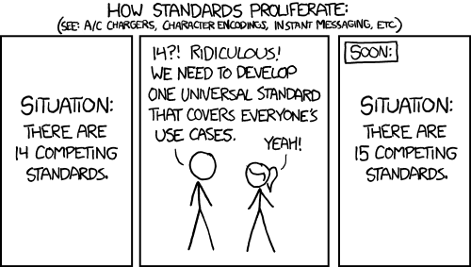
Standards - https://xkcd.com/927/

Slide 16
SSO – Single sign on
Physician/medical employee context
Sometimes it work…
(HIS, Workstation level…)

Slide 17
Standards - https://xkcd.com/927/

Slide 18
Standards that do work
A4 (exception: US)
PDF (important: digital signature systems). No structure
HL7 (somehow… between HIS and RIS/LIS)
DICOM (… but)
~XML
No wirespread standard for signals (ECG, EEG) (even ECG paper roll)
No adoption of DICOM SR
They work only if it is a must.

Slide 19

DICOM
IMAGING DATA

Slide 20
Lack of standard?
Give the user ENTIRE environment!
…at least for one task
By one company.
Just ignore the standard.
… and make them pay for the entire enviroment.
DICOM/VNA in Ophtalmology?
… embedded PDF
… 3D OCT mostly without pixel spacing

Slide 21
User attention
Give the user ENTIRE environment!
Entire enviroment = entire attention (for a while)
Tool switching = attention switching = bad

Slide 22
Vendor lock-in
In economics, vendor lock-in, also known as proprietary lock-in or customer lock‑in, makes a customer dependent on a vendor for products, unable to use another vendor without substantial switching costs.
DICOM/VNA in Ophtalmology?
… embedded PDF
… 3D OCT mostly without pixel spacing

Slide 23
Data in a clinical environment
Patient itself – ultimate source of data, and „the data” itself
Operators of the devices, Physicians (Humans)
Acquisition devices (CT, MRI, OCT, US, X-ray, ECG, EEG), Hardcopy (paper)
Dedicated, modality specific tools (eg. Head CT Perfusion analysis software)
PACS – Picture Archive and Communication System,
RIS – Radiological Information System, LIS (Laboratory Information System)
HIS – Hospital Information System
Country-wide tools (Centrum e-Zdrowia/NFZ): SMPT (System Monitorowania programów terapeutycznych), SIMP (System Informatyczny Monitorowania Profilaktyki), SRU (System Rozliczeń Uzdrowisk), AP-KOLCE (Kolejki Centralne)
DICOM
HL7
XML

Slide 24
DATA LOSS IN THE PROCESS!
Patient itself – ultimate source of data, and „the data” itself
Operators of the devices, Physicians (Humans)
Acquisition devices (CT, MRI, OCT, US, X-ray, ECG, EEG), Hardcopy (paper)
Dedicated, modality specific tools (eg. Head CT Perfusion analysis software)
PACS – Picture Archive and Communication System,
RIS – Radiological Information System, LIS (Laboratory Information System)
HIS – Hospital Information System
Country-wide tools (Centrum e-Zdrowia/NFZ): SMPT (System Monitorowania programów terapeutycznych), SIMP (System Informatyczny Monitorowania Profilaktyki), SRU (System Rozliczeń Uzdrowisk), AP-KOLCE (Kolejki Centralne)
DICOM
HL7
XML

Slide 25
DATA EXTRACTION IN THE PROCESS?
Patient itself – ultimate source of data, and „the data” itself
Operators of the devices, Physicians (Humans)
Acquisition devices (CT, MRI, OCT, US, X-ray, ECG, EEG), Hardcopy (paper)
Dedicated, modality specific tools (eg. Head CT Perfusion analysis software)
PACS – Picture Archive and Communication System,
RIS – Radiological Information System, LIS (Laboratory Information System)
HIS – Hospital Information System
Country-wide tools (Centrum e-Zdrowia/NFZ): SMPT (System Monitorowania programów terapeutycznych), SIMP (System Informatyczny Monitorowania Profilaktyki), SRU (System Rozliczeń Uzdrowisk), AP-KOLCE (Kolejki Centralne)
DICOM
HL7
XML

Slide 26
CURRENT OUTBREAKS
Patient itself – ultimate source of data, and „the data” itself
Operators of the devices, Physicians (Humans)
Acquisition devices (CT, MRI, OCT, US, X-ray, ECG, EEG), Hardcopy (paper)
Dedicated, modality specific tools (eg. Head CT Perfusion analysis software)
PACS – Picture Archive and Communication System,
RIS – Radiological Information System, LIS (Laboratory Information System)
HIS – Hospital Information System
Country-wide tools (Centrum e-Zdrowia/NFZ): SMPT (System Monitorowania programów terapeutycznych), SIMP (System Informatyczny Monitorowania Profilaktyki), SRU (System Rozliczeń Uzdrowisk), AP-KOLCE (Kolejki Centralne)
AI in data acquistion
DICOM
Segmentation tools
STTs
HL7
LLMs
XML

Slide 27
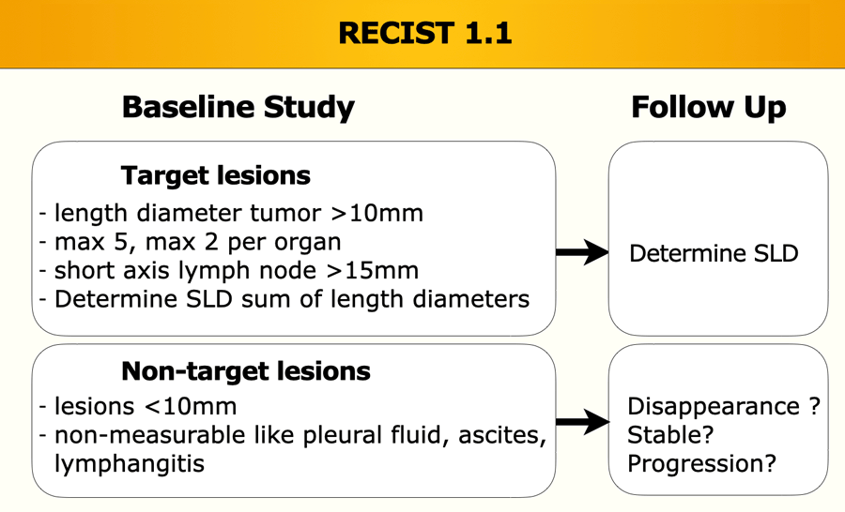
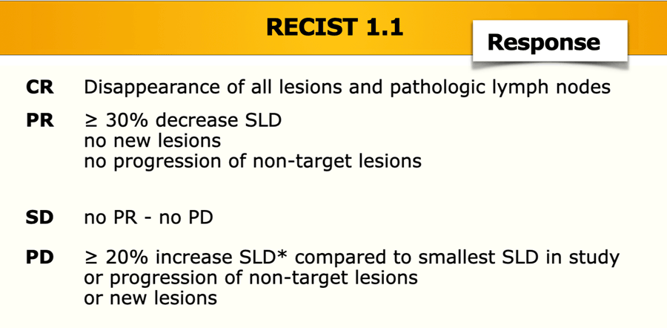
Segmentation tools vs recist

Slide 28
Segmentation
Intuitevly: tumor volume is better measure than SLD (Sum of Longest Diameters)
It might be.
Does it really matter?
Recist has been good enough.
AutoRECIST?

Slide 29
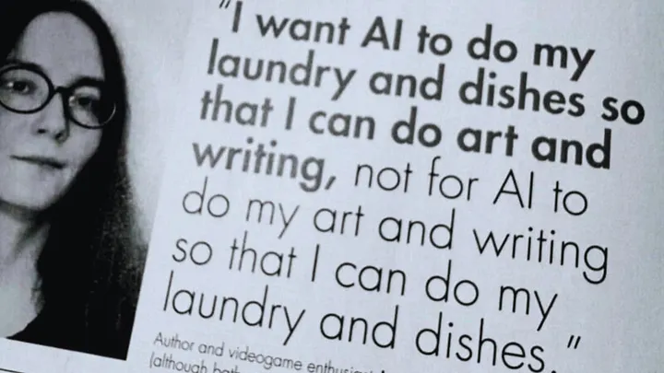
Role of Ai

Slide 30
Role of AI… of Engineering?
Do my dishes! My dishes are:
  Data transfer between systems
  Keep clinical context
  Give me prior data, whereever they are
  OK, sometimes count the individual pixels for me
  Alert me in emergency
  Perform Speech to Text, keep my EMR free of ortography mitsakes

Slide 31
Role of ai
Don’t try to replace me,
I’m doing hard already.
Just do my dishes.

